Slide 1




AT82.02
Data Modeling and Management
Unit 4-1 Transaction Processing & Consistency Models
Chutiporn Anutariya (chuti at ait dot ac dot th)

Slide 2

What is a Transaction?

Slide 3

A transaction is …
A sequence of actions that read from and/or write to a database.
It could be any combination of CRUD operations.

Slide 4
What is ACID Model?

Slide 5
ACID Transactions:
ACID
Consistency
Isolation
Durability
Atomicity

Slide 6
ACID
Atomicity
Consistency
Isolation
Durability
A transaction is an atomic unit of processing; it is either performed in its entirety or not performed at all.
An execution of the transaction must take the database from one consistent state to another.
A transaction should not make its updates visible to other transactions until it is committed.
Once the transaction is complete, it will persist as complete and cannot be undone.

Slide 7

One of the biggest changes from a centralized relational database to a cluster-oriented NoSQL database is the concept of “consistency”.

Slide 8
Relational databases focuses on the concept of strong consistency
In NoSQL, we will consider various different forms and degrees of consistency

Slide 9
Several Forms of Consistency
Update Consistency
write-write conflict: two transactions/users update the same data item at the same time
lost update problem
Read Consistency
read-write conflict
inconsistent read
dirty read

Slide 10
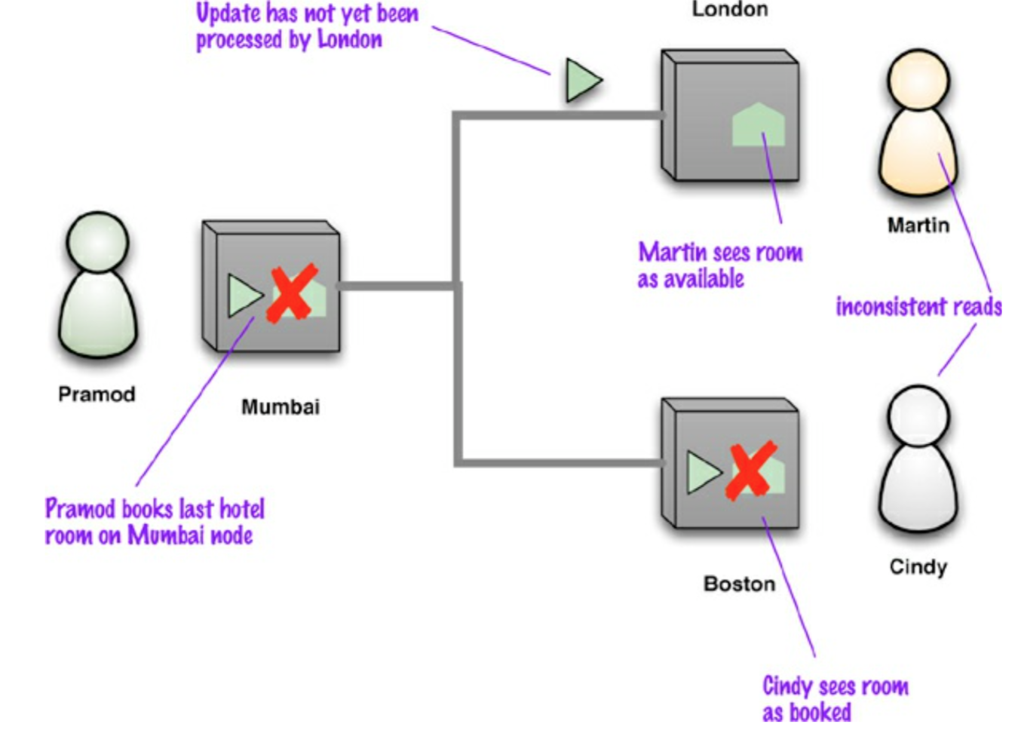
Several Forms of Consistency
Replication Consistency
Ensuring the same data item has the same value when read from different replicas

Slide 11
Several Forms of Consistency
Eventual Consistency
Nodes may have replication inconsistencies, but if there are no further updates, eventually all nodes will be updated to the same value.
Inconsistency window
The length of time an inconsistency is present.
Meaning that different people will see different things at the same time.
Ex: you may post a message using one node, then refresh your browser, but the refresh goes to a different node, which hasn’t received your post yet -- look like the post was lost.

Slide 12
Several Forms of Consistency
User-perceived Consistency
The time expected by the customer to see the updated value.
Read-your-write Consistency
Once you’ve made an update, you are guaranteed to continue seeing the update.
Session Consistency
Within a user’s session, there is read-your-writes consistency
The user may lose consistency should their session end, or should the user access the system from different computers.

Slide 13
Degrees of Consistency
Strong Consistency
After the update completes, any subsequent access (by A, B or C) will return the updated value.
Weak Consistency
The system does not guarantee that subsequent accesses will return the updated value. A number of conditions need to be met before the value will be returned. Often this condition is the passing of time, i.e., the inconsistency window.
Eventual Consistency
The system guarantees that if no new updates are made, eventually (after the inconsistency window closes) all accesses will returned the last updated value.

Slide 14
Whether inconsistency is acceptable and which degree of consistency is acceptable depends foremost on the client application.

Slide 15
Consistency Relaxation
Inconsistency can be tolerated for two reasons:
For improving read and write performance under highly concurrent conditions and
For handling partition cases where a majority model would render part of the system unavailable even though the nodes are up and running.

Slide 16
BASE Transactions

Slide 17
BASE Transactions
Basic
Availability
Indicates that the system does guarantee availability, in terms of the CAP theorem
Fulfills request, even in partial consistency
Soft state
Indicates that the state of the system may change over time, even without input. This is because of the eventual consistency model.
Data consistency is the developer's problem and should not be handled by the database.
Eventual consistency
At some point in the future, data will converge to a consistent state; delayed consistency, as opposed to immediate consistency of the ACID properties

Slide 18
BASE Transactions
A BASE datastore values availability (since that’s important for scale).
Overall, the BASE consistency model provides a less strict assurance than ACID.
BUT it doesn’t offer guaranteed consistency of replicated data at write time.
Base Transactions
Data will be consistent in the future, either at read time or it will always be consistent, but only for certain processed past snapshots.

Slide 19

P. Sadalage and M. Fowler: NoSQL Distilled: A Brief Guide to the Emerging World of Polyglot Persistence, Addison-Wesley Professional, 2013

Slide 20

Thank you.
Let’s Summarize!

